Slide 1
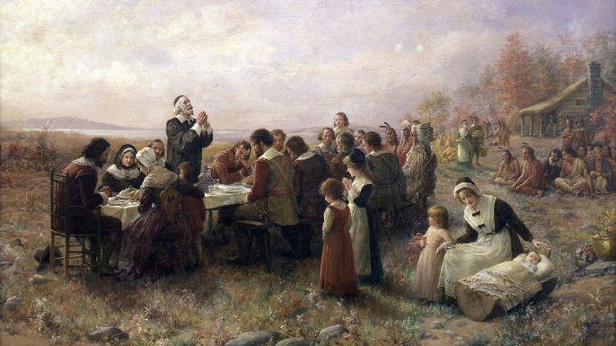
THE UNTOLD TRUTHS OF THANKSGIVING
1. The principles that led them to come to America
- Separation 2 Cor. 6:17, 18
- Religious freedom
- For the glory of God & advancement of the Christian faith
2. The principle that produced the great harvest
- Each individual is entitled to the fruits of his labor
- It was after the failure of collectivism/socialism

